Slide 1





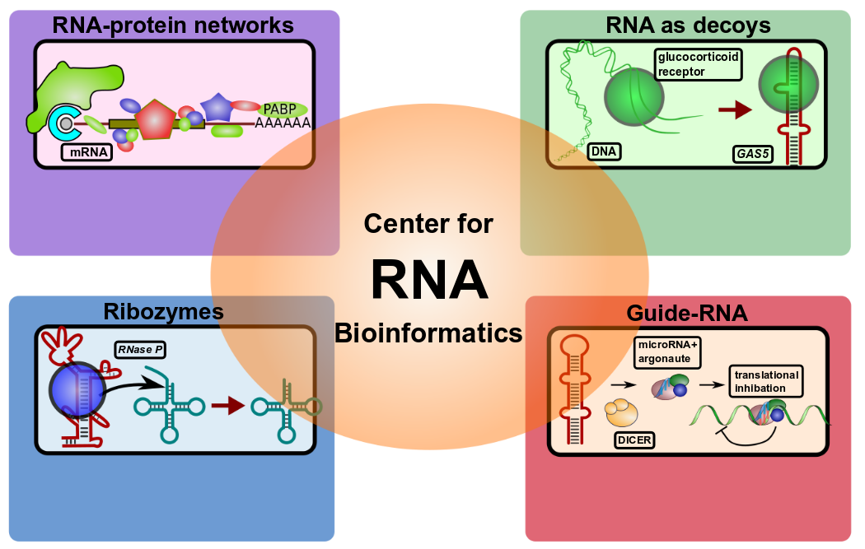
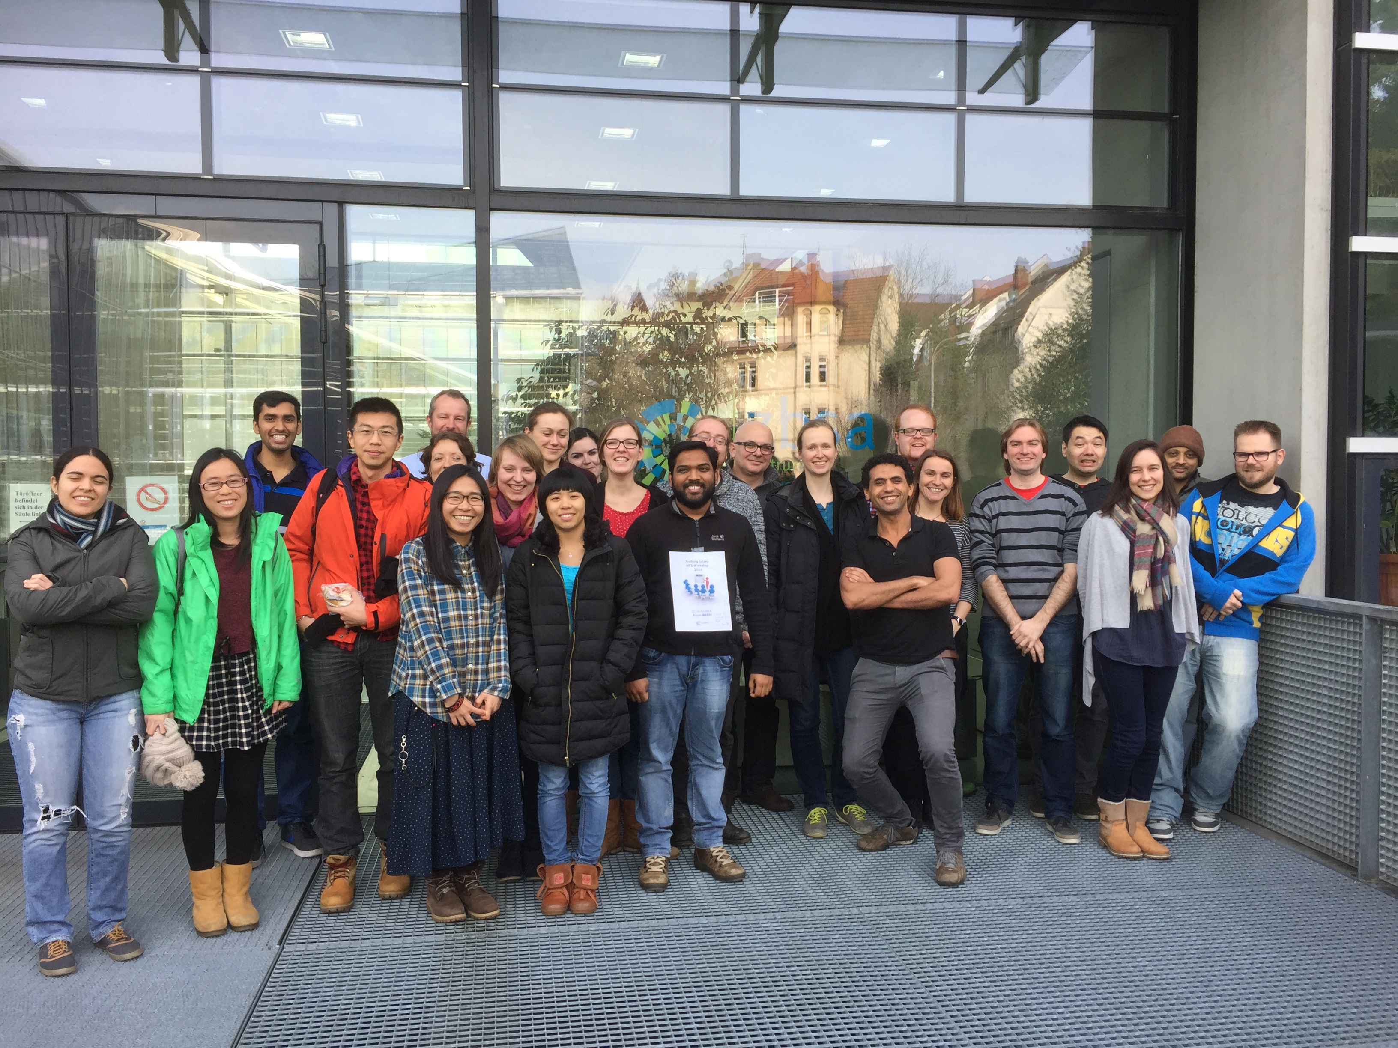
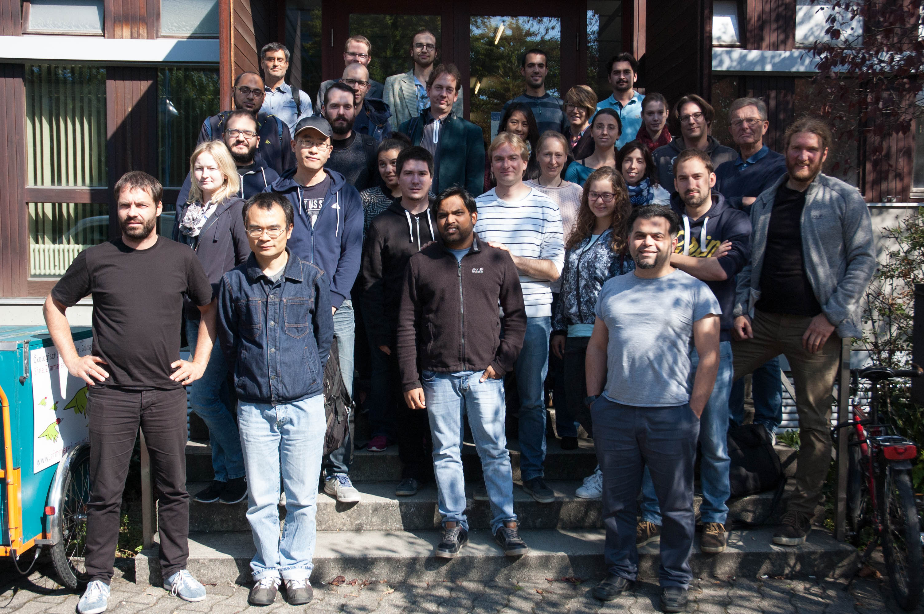




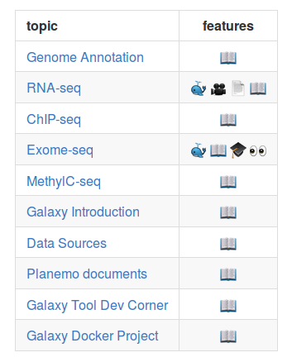




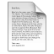





de.NBI − German Network for Bioinformatics Infrastructure
RBC
RNA Bioinformatics Center
University of Freiburg
Chair of Prof. Rolf Backofen
Rolf Backofen, Bérénice Batut, Anika Erxleben, Björn Grüning, Torsten Houwaart, Joachim Wolff
RNA Bioinformatics Center, University of Freiburg, Germany
Short description of the project
de.NBI services
Progress Report
de.NBI services
Progress Report
The RBC at the University of Freiburg offers tools, services and training for the analysis of RNA - RNA interactions, RNA - Protein interactions.
- Organisation of workshops aimed at teaching users common HTS techniques
- Organisation of hackathons aimed at making software more readily available
- Ongoing evaluation of new methods and software for RNA-RNA and RNA-protein interactions, definition of SOP pipelines.
- Finished migration of all our training material and documentation of standard analysis workflows to online repositories for easier collaboration
- Ongoing curation of training material to include newer versions of tools and replace deprecated tools
- Ongoing development of new training material to cover emerging new techniques requested by users
- Active Participation in BioStars to offer answers to frequently asked user-questions
- analysis of CLIPseq data
- detection of RNA motifs
- RNA-protein interactions
- RNA structure prediction
- detection of ncRNAs
- RNA structure prediction
- RNA conserveration
- ncRNA target prediction
- miRNA/ncRNA detection
de.NBI Services
de.NBI training and education
Freiburg Galaxy Server for accesible, reproducible and transparent research in biomedical sciences.
Available for all german research facilities in 2017 as part of the de.NBI cloud.
http://galaxy.uni-freiburg.de
HTS-data analysis / Galaxy Workshop
Twice per year
Seven workshops since 2013 each with ~ 30 participants
6th - 7th April 2016, Galaxy DevOps Workshop, Heidelberg
20th - 21st October 2016, Swiss German Galaxy Workshop, Freiburg
27th October 2016, de.NBI data management Workshop, Kassel
Upcoming Events
15th - 16th December 2016, RNA-sequencing Data Analysis Workshop, Freiburg
13th - 17th February 2017, HTS/Galaxy Workshop, Freiburg
Hands-On Training Material for Self Study Available
Active involvement in making software, relevant for HTS analysis, RNA - protein interaction (e.g. CLIP experiments) analysis, RNA - RNA interaction analysis, accesible. Tools are made available through distribution channels like Conda.
https://bioconda.github.io/
Server for a series of RNA research tools for sequence-structure alignments (LocARNA, CARNA, MARNA), clustering (ExpaRNA), interaction prediction (IntaRNA, CopraRNA), homolog identification (GLASSgo), sequence design (AntaRNA, INFORNA, SECISDesign), CRISPR repeat analyses (CRISPRmap) and many more tasks.
http://rna.informatik.uni-freiburg.de/
Analysis platforms for specific tasks are made available as Docker images which incorporate a Galaxy web server with seemlessly included tools, SOP analysis pipelines, training material and help pages.
https://hub.docker.com
/r/bgruening/galaxy-rna-workbench/
HTS/Galaxy workshop
22 - 26 Feb 2016
HTS/Galaxy workshop
19 - 23 Sep 2016
https://github.com
/bgruening/training-material
Publications
Docker Image Available
Video Available
Tour Available
Galaxy Page Available
Annotated Text Available
Introductory Slides Available
“Tools and data services registry: a community effort to document bioinformatics resources.” doi: 10.1093/nar/gkv1116
“The Galaxy platform for accessible, reproducible and collaborative biomedical analyses: 2016 update.” doi: 10.1093/nar/gkw343
“Enhancing pre-defined workflows with ad hoc analytics using Galaxy, Docker and Jupyter.” doi: 10.1101/075457
“Global RNA recognition patterns of post-transcriptional regulators Hfq and CsrA revealed by UV crosslinking in vivo.” doi: 10.15252/embj.201593360
“RC3H1 post-transcriptionally regulates A20 mRNA and modulates the activity of the IKK/NF-kappaB pathway” doi:10.1038/ncomms8367
Förderkennzeichen Nr…..
http://www.denbi.de

